Slide 1
SQL Firewall In Oracle Database 23c
Oracle Database Free - Developer Release
Name
Angeline Janet Dhanarani,
Database Security Product Management,
April 10, 2023

Slide 2
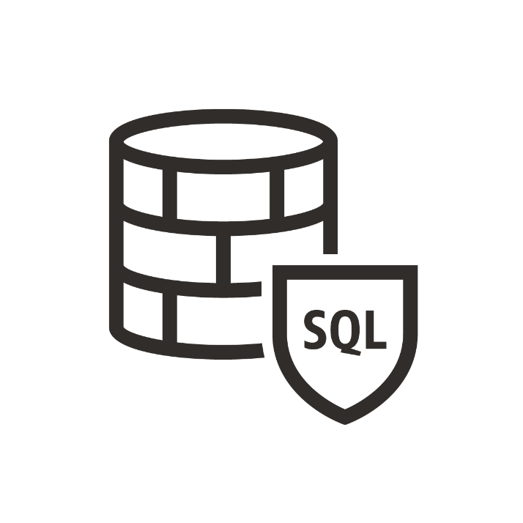
What is Oracle SQL Firewall?
Oracle SQL Firewall offers real-time protection against common database attacks by monitoring and blocking “unauthorized SQL” and SQL injection attacks from inside the database.
SQL Firewall is embedded and built into the 23c database, ensuring that it cannot be bypassed. Embedding also gives the firewall full visibility into the top-level SQL, stored procedures and the related database objects.
SQL Firewall is trained for trusted application SQL traffic and trusted application paths to constitute the “allow-list”, then detects, blocks, and logs any unexpected SQL

Slide 3
Use cases and benefits
Use cases
Allow approved SQL only: Detect and optionally block unauthorized SQL including SQL injection
Limit DB connections to an authorized IP address, user and program
Mitigates risk of exploitation with credential theft/abuse
Benefits
Transparent protection to applications/ client programs
Enforcement regardless of SQL execution path
One-stop SQL firewall solution for ALL Oracle Database deployments
Notes:
Transparent protection to applications/ users – No changes required for your applications/ client programs
Enforcement regardless of SQL execution path - Enforcement regardless of SQL Entry point - SQLs issued over the network or from bequeath connection, encrypted or not, stored procedures or user-initiated
Mitigates risk of exploitation with credential theft/abuse -streamlining identity checks through allowed session contexts (like client IP address, OS program name, and OS username) and/or allowed objects.

Slide 4
Why is SQL Firewall important?
Unlike external network-based database firewalls, SQL Firewall enforcement is independent of the session path - it does not matter if SQL is issued over the network or from bequeath (local) connections, encrypted or clear text, by stored procedures or user-initiated.
By enforcing the allow-list of SQL and database objects, it can prevent many zero-day attacks.
SQL Firewall works in conjunction with other Oracle Database security features such as Database Vault, TDE, Auditing, and others to monitor and detect, and optionally block any SQL anomalies.
It reduces the risk of credential theft/abuse by enforcing session context information.

Slide 5

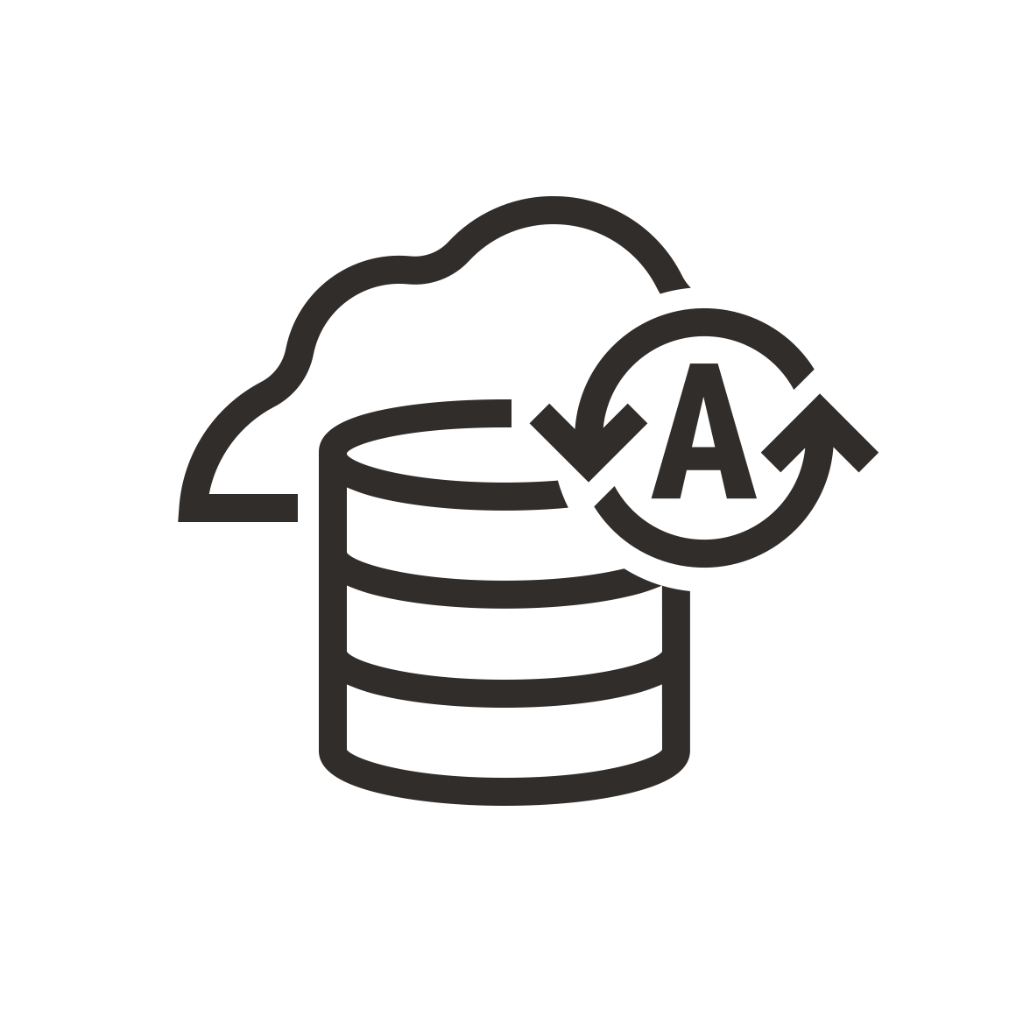







SQL firewall for ALL Oracle Database deployments
Data Guard
Autonomous Database
Exadata
On-premises Database
Exadata Cloud at Customer
Database Container
Exadata Cloud Service
Database Pluggable
DBCS

Slide 6
SQL Firewall Positioning compared to other security features
 | Use Cases | Database Features
Monitoring | Track All DBA activities Track all DML and DDL from non-application connections Alerts on Truncate of a table Log all DDLs | Unified Audit FGA
Command/Object-based Control | Block access to sensitive objects Block critical commands | Database Vault
Context-based Control | Block specified users from a list of IP addresses Allow OS and DB users from certain programs only | Database Vault SQL Firewall
SQL-based Control | Allow known SQLs only Identify and block unseen SQLs | SQL Firewall

Slide 7
Addressing challenges with existing network-based database firewalls
 | Issue | Description
1 | Client network reconfiguration is cumbersome, seldom attempted | DB Firewalls needs to be placed in-line to database traffic. Clients must route through firewalls instead of database
2 | Network-based SQL firewalls are a single-point of failure | High-availability deployments are complex and fragile
3 | Encrypted SQL traffic requires additional processing | DB Firewalls require termination of the encrypted SQL traffic prior to processing, or must be configured for TLS certificate exchange
4 | Limited to SQL traffic over the network | SQL traffic from stored procedure execution cannot be monitored SQL traffic over bequeath or local connection cannot be monitored
5 | Limited execution capabilities | No visibility into real object information (e.g., CURRENT_SCHEMA, synonyms) Blocking SQL may disrupt transactions
SQL Firewall within Oracle Database will not have any of these constraints!

Slide 8
SQL-based Control
For every database user to be protected
Capture
Analyze
Allow-List
Enforce
Learning Stage
Capture SQL activities
Verify / Validate
Protecting Stage
Generate allow-list (SQL + context)
Enforce (log and block/allow)

Slide 9
SQL Capture
SQL Firewall administrators can create/drop/start/stop SQL capture
Captured SQL
Capture session-unique SQLs
Session context: session user, client IP address, program name, and OS username
SQL text (normalized)
Accessed objects
Execution context: current user ID and whether the SQL is top level
Configurable option
Capture top-level SQLs only or all SQL executions including recursive SQLs
exec dbms_sql_firewall.create_capture(username => 'APP_RUNTIME');
DBA_SQL_FIREWALL_CAPTURE_LOGS
Notes:
SQL Firewall administrators: Users with the SQL_FIREWALL_ADMIN role

Slide 10
Allow-List Generation
After SQL capture, the SQL Firewall administrators can generate an allow-list
exec dbms_sql_firewall.generate_allow_list(username => 'APP_RUNTIME');
Allowed_Contexts
Client IP address
OS program name
OS username
Enforce-able during database connections
Allowed_SQLs
SQL Statement
Execution context
Enforce-able during SQL executions
DBA_SQL_FIREWALL_ALLOWED_IP_ADDR
DBA_SQL_FIREWALL_ALLOWED_OS_USER
DBA_SQL_FIREWALL_ALLOWED_OS_PROG
DBA_SQL_FIREWALL_ALLOWED_SQL

Slide 11
Allow-List Enforcement
After allow-list generation, the SQL Firewall administrators should be able to enable allow-lists with enforcement options and protection mode
exec dbms_sql_firewall. enable_allow_list(username => 'APP_RUNTIME’, enforce=>dbms_sql_firewall.enforce_context, block => FALSE);
Enforcement options
ENFORCE_SQL: SQL check only
ENFORCE_CONTEXT: Context check only
ENFORCE_ALL: SQL check and context check
Enforcement options for violations
Block: True: ORA-47605: SQL Firewall violation
SQL Firewall will generate a violation log for every unmatched event
DBA_SQL_FIREWALL_ALLOW_LISTS

Slide 12
SQL Firewall Violations
For every unmatched SQL Firewall violation event (block=true/false), system populates:
DBA_SQL_FIREWALL_VIOLATIONS
Column | Description
USERNAME | Database Username
COMMAND_TYPE | Type of SQL command
SQL_SIGNATURE | SQL signature that should be allowed
SQL_TEXT | SQL text
ACCESSED_OBJECTS | Accessed objects
CURRENT_USER | Name of the user that SQL was executed as
TOP_LEVEL | Y or N
IP_ADDRESS | Client IP address
CLIENT_PROGRAM | Name of the client program for the session
OS_USER | Name of the OS user
CAUSE | SQL violation or CONTEXT violation
FIREWALL_ACTION | BLOCKED or ALLOWED
OCCURRED_AT | Time of the violation

Slide 13
Auditing SQL Firewall
Mandatory audit for SQL Firewall admin operations:
Configurable unified audit policy for SQL violation and context violation events:
CREATE AUDIT POLICY APPLICATION_AUDIT_POLICY ACTIONS COMPONENT = SQL_FIREWALL [SQL VIOLATION | CONTEXT VIOLATION | ALL] ON APP_RUNTIME;

Slide 14
Allow-List Management
Enable/Disable allow-lists
Update allow-lists enforcement options (block/permissive mode)
Modify allowed context values (IP addresses, program names)
Drop/Append allow-lists
Export/Import allow-lists
Create and manage firewall-related audit policy
CREATE AUDIT POLICY <policy name> ACTIONS COMPONENT = SQL_FIREWALL [SQL VIOLATION | CONTEXT VIOLATION | ALL] ON <username>;
API to purge capture/violation logs based on username or timestamp

Slide 15
Call to action
Oracle Database 23c Free - Developer Release:
In one of the PDBs, run the demo script within SQLFirewallDemoScript document providing the sys password
The script creates SQL Firewall administrative users to enable and administer the SQL Firewall, schema users and application users.
The script demonstrates how you can run the capture and generate allow-list for application user app_runtime, and enable SQL Firewall protection for this user.
The script also enables sample workload execution to generate SQL Firewall violation events and audit events.

